Slide 1
Advance Statistics
Analysing Student Behaviour
By. 3143 SURAJ SHETE

Slide 2
Objective:
01.
02.
03.
Explore Student Behavior Data:
Evaluate Data Quality and Completeness:
Visualize Data:
04.
Perform Hypothesis Testing:
Test hypotheses related to student behavior and academic performance.
Determine significant associations between variables.

Slide 3
About the Dataset
01.
02.
03.
Dataset contains 19 columns that provides information about
the student department, percentage, stress level, working or not
and their financial condition.
It contains 84 rows.
The data is been manually collected with the help of survey.

Slide 4
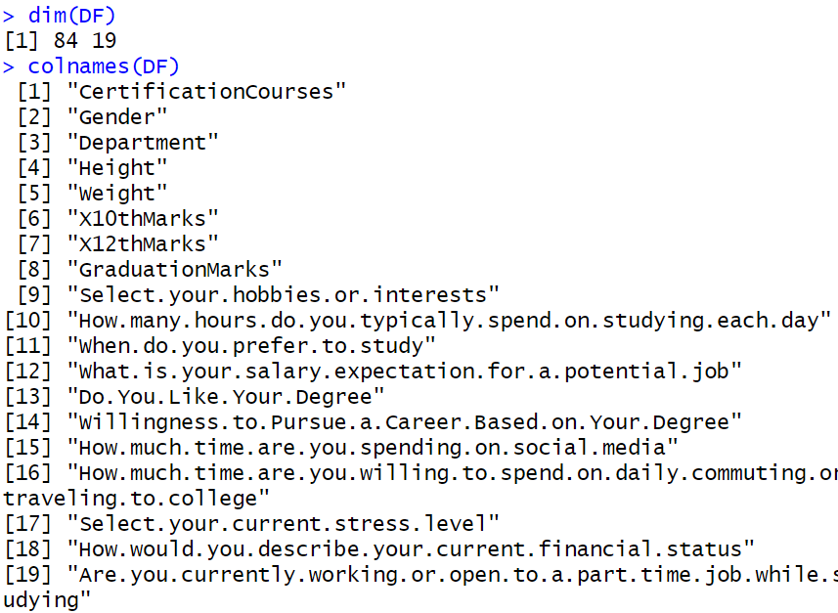
Data Pre-processing:
As we can see there are total 84 rows and 19 columns
Using colnames() function finding name of all the attributes

Slide 5
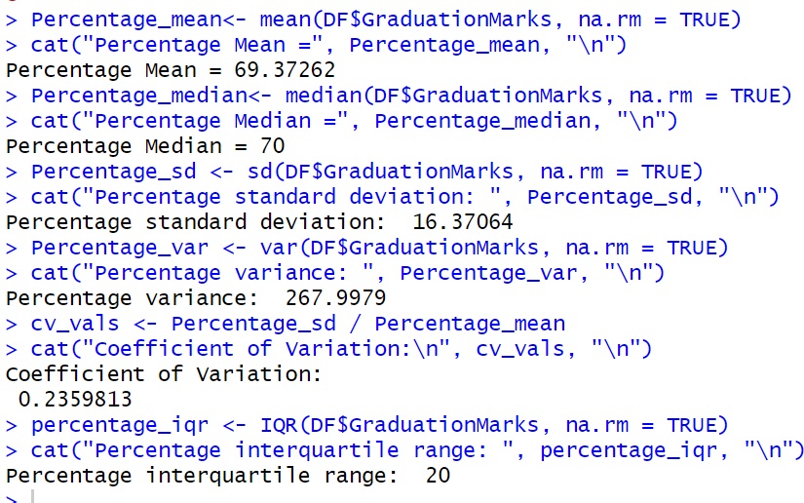
Descriptive Statistics:
Performing Descriptive Statistics for quantitative measure
Percentage
Mean = 69.38
Median = 70
SD = 16.38
Var = 268

Slide 6
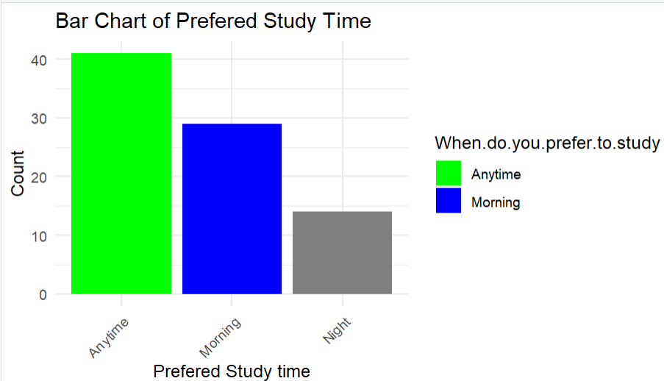
Data Visualization:
Bar plot for preferred time to study
A bar chart displaying the distribution of preferred study time.
Most prefer time to study is Anytime while
Majority prefer studying in the morning, followed by anytime and night.

Slide 7
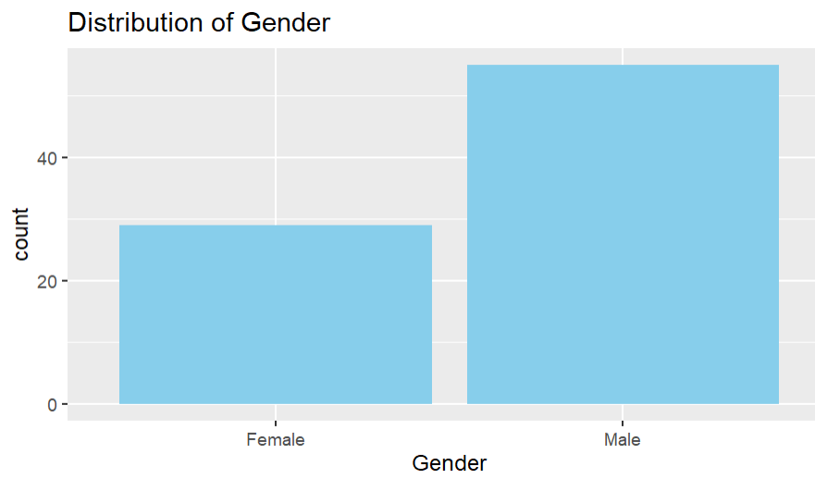
Bar plot for distribution of Gender:
Bar plot for distribution of Gender.
Male gender has the highest count.

Slide 8
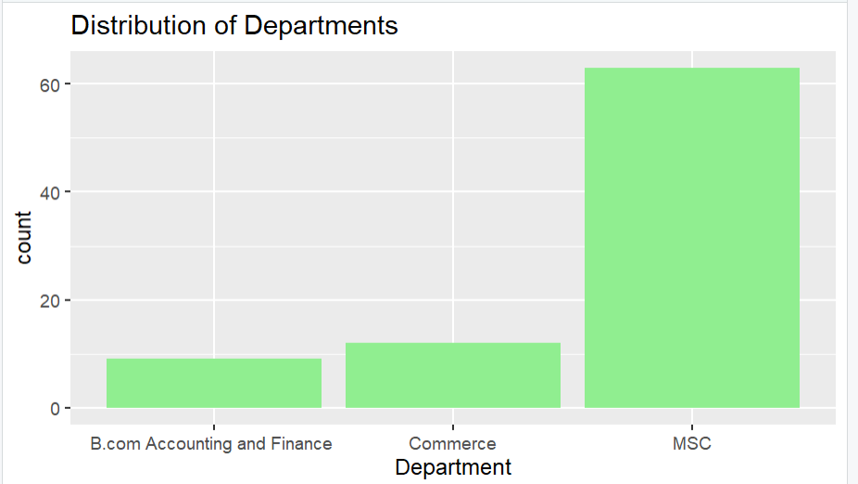
Bar plot for distribution of Department:
Bar plot for distribution of Department.
MSC department hast the highest count rather than B.com and Commerce

Slide 9
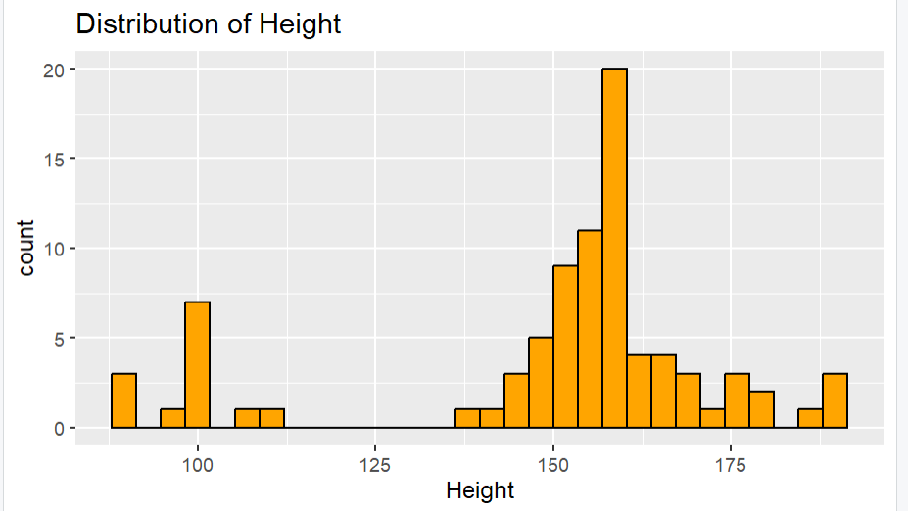
Histogram plot for Height:
Histogram for Height.
The count for distribution of height is more between 150-175
And the highest count for height lies between 160-165

Slide 10
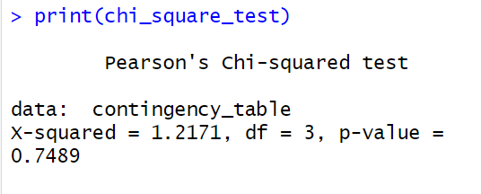
Hypothesis Testing: Chi-square test
Null Hypothesis (H0): There is no significant association between Certification Courses and Willingness to Pursue a Career Based on Your Degree.
Alternative Hypothesis (H1): There is a significant association between Certification Courses and Willingness to Pursue a Career Based on Your Degree.
Result: p-value = 0.7489 > 0.05, accept the null hypothesis suggesting no significant association between Certification Courses and Willingness to Pursue a Career Based on Your Degree.

Slide 11
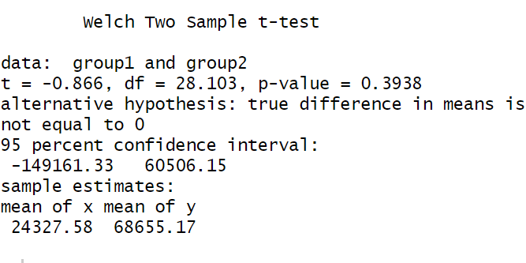
Hypothesis Testing: Two sample t-test
- Null Hypothesis (H0): There is no difference in the mean salary expectations between male and female respondents.
-Alternative Hypothesis: There is a difference in the mean salary expectations between male and female respondents.
- Result: Accept the null hypothesis p= 0.3938 (p > 0.05), suggesting no significant difference in the mean salary expectations between male and female respondents.

Slide 12
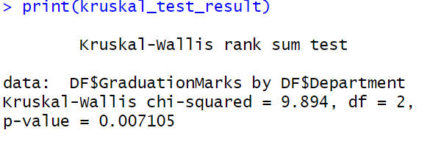
Hypothesis Testing: Kruskal-Wallis Test
Null Hypothesis (H0): There is no difference in the median graduation marks among the different departments.
Alternative Hypothesis (H1): There is a difference in the median graduation marks among the different departments.
Result: p-value = 0.007105 < 0.05, we reject the null hypothesis so there is a difference in the median graduation marks among the different departments.

Slide 13
Conclusion:
01.
02.
03.
Statistical tests including Chi-square, T-test, and Kruskal-Wallis were conducted to test hypotheses.
Significant associations were found between graduation marks
and department.
The analysis provides valuable insights into student behavior,
academic performance, and factors influencing student
outcomes.

Slide 14
Thank You!

